Slide 1
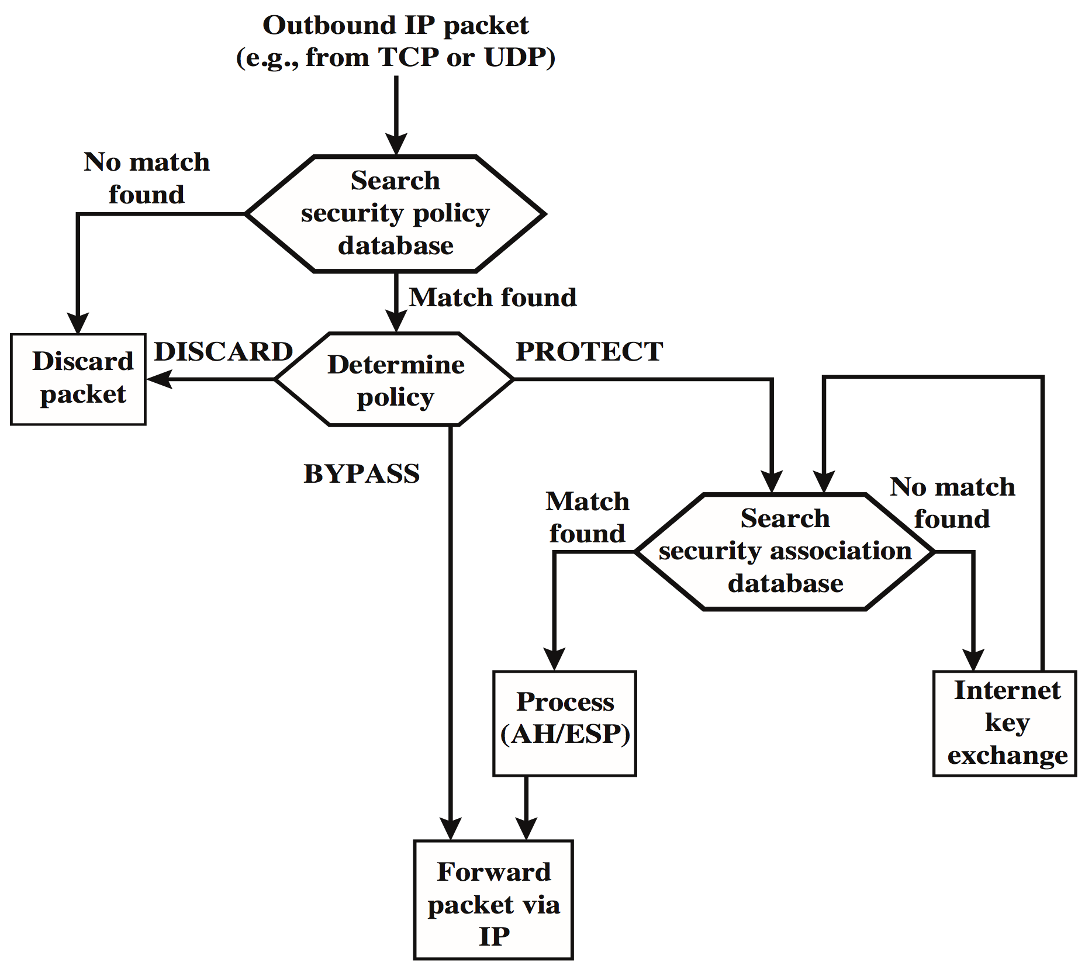
Processing Model for IP Packets
Notes:
Figure 9.3 highlights the main elements of IPsec processing
for outbound traffic. A block of data from a higher layer, such as TCP, is passed
down to the IP layer and an IP packet is formed, consisting of an IP header and an
IP body. Then the following steps occur:
1. IPsec searches the SPD for a match to this packet.
2. If no match is found, then the packet is discarded and an error message is
generated.
3. If a match is found, further processing is determined by the first matching
entry in the SPD. If the policy for this packet is DISCARD, then the packet is
discarded. If the policy is BYPASS, then there is no further IPsec processing;
the packet is forwarded to the network for transmission.
4. If the policy is PROTECT, then a search is made of the SAD for a matching
entry. If no entry is found, then IKE is invoked to create an SA with the appropriate
keys and an entry is made in the SA.
5. The matching entry in the SAD determines the processing for this packet.
Either encryption, authentication, or both can be performed, and either transport
or tunnel mode can be used. The packet is then forwarded to the network
for transmission.

Slide 2
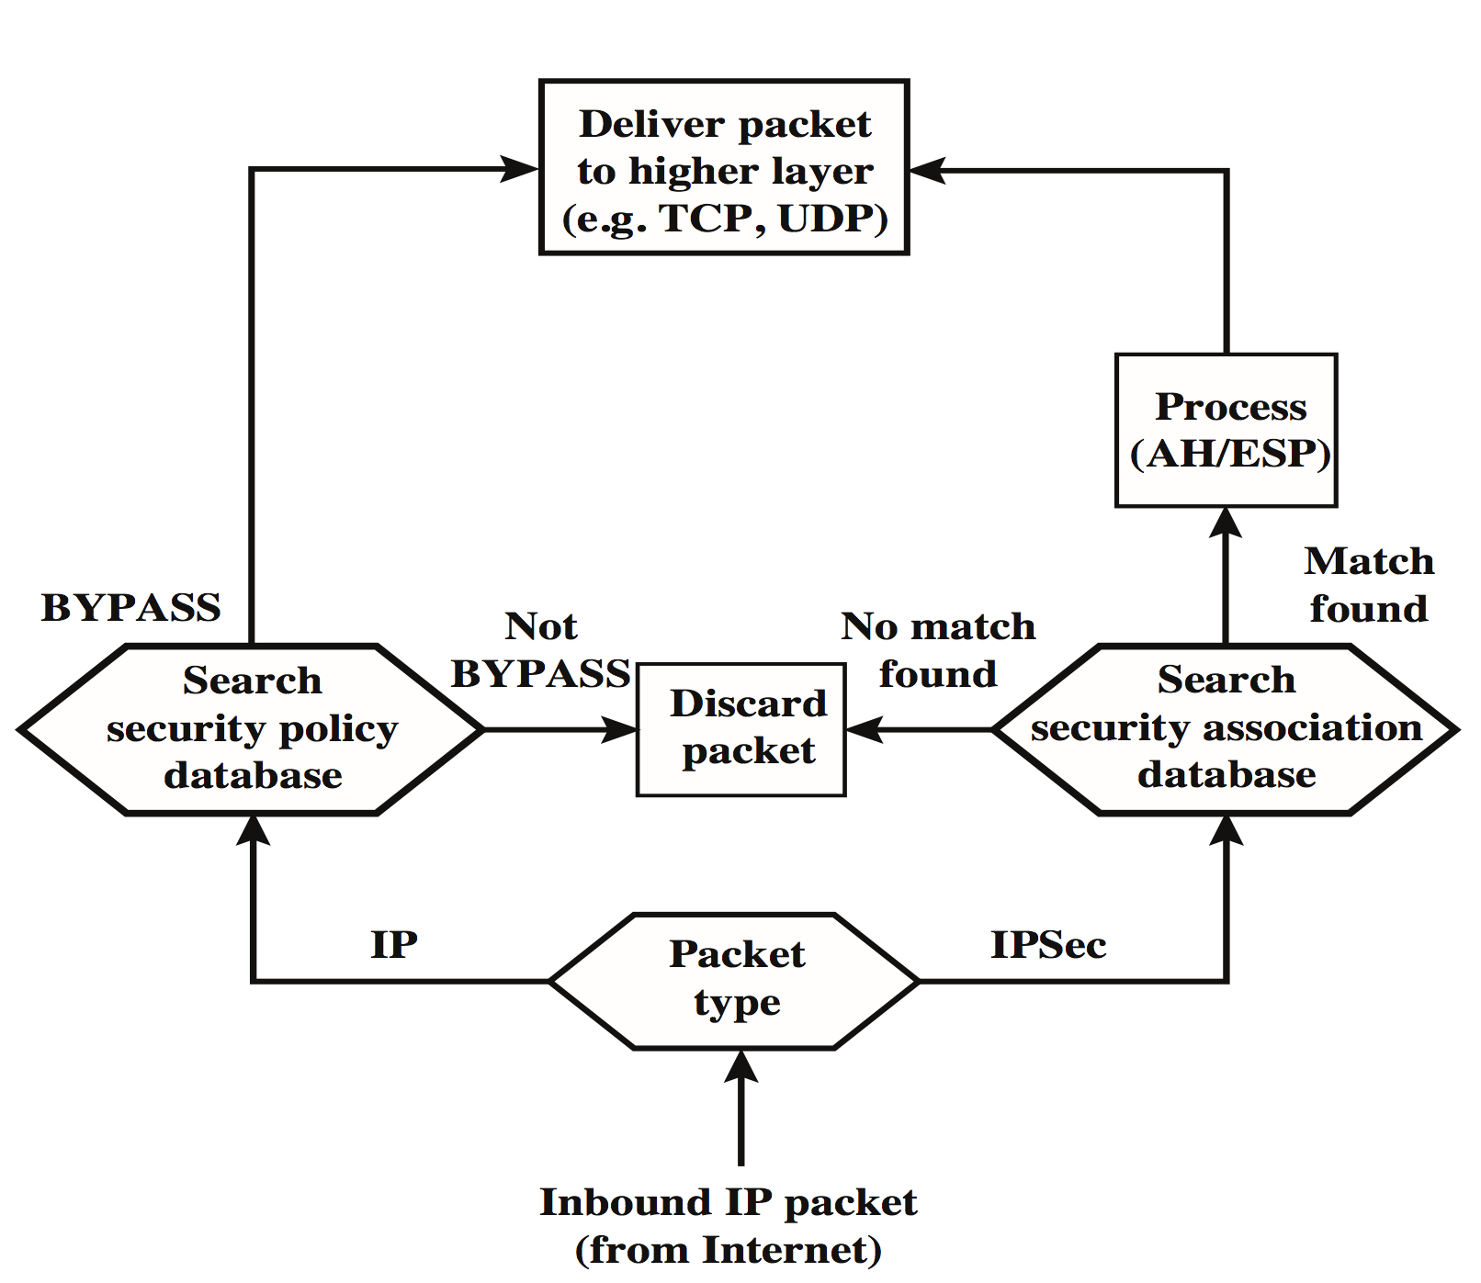
Processing Model for Inbound IP Packets
Notes:
Figure 9.4 highlights the main elements of IPsec processing for
inbound traffic. An incoming IP packet triggers the IPsec processing.

Slide 3
Encapsulating Security Payload (ESP)
Used to encrypt the Payload Data, Padding, Pad Length, and Next Header fields
If the algorithm requires cryptographic synchronization data then these data may be carried explicitly at the beginning of the Payload Data field
An optional ICV field is present only if the integrity service is selected and is provided by either a separate integrity algorithm or a combined mode algorithm that uses an ICV
ICV is computed after the encryption is performed
This order of processing facilitates reducing the impact of DoS attacks
Because the ICV is not protected by encryption, a keyed integrity algorithm must be employed to compute the ICV
The Padding field serves several purposes:
If an encryption algorithm requires the plaintext to be a multiple of some number of bytes, the Padding field is used to expand the plaintext to the required length
Used to assure alignment of Pad Length and Next Header fields
Additional padding may be added to provide partial traffic-flow confidentiality by concealing the actual length of the payload
Notes:
The Payload Data, Padding, Pad Length, and Next Header fields are encrypted by
the ESP service. If the algorithm used to encrypt the payload requires cryptographic
synchronization data, such as an initialization vector (IV), then these data may be
carried explicitly at the beginning of the Payload Data field. If included, an IV is
usually not encrypted, although it is often referred to as being part of the ciphertext.
The ICV field is optional. It is present only if the integrity service is selected
and is provided by either a separate integrity algorithm or a combined mode algorithm
that uses an ICV. The ICV is computed after the encryption is performed.
This order of processing facilitates rapid detection and rejection of replayed or
bogus packets by the receiver prior to decrypting the packet, hence potentially
reducing the impact of denial of service (DoS) attacks. It also allows for the possibility
of parallel processing of packets at the receiver that is decryption can take
place in parallel with integrity checking. Note that because the ICV is not protected
by encryption, a keyed integrity algorithm must be employed to compute
the ICV.
The Padding field serves several purposes:
• If an encryption algorithm requires the plaintext to be a multiple of some
number of bytes (e.g., the multiple of a single block for a block cipher), the
Padding field is used to expand the plaintext (consisting of the Payload Data,
Padding, Pad Length, and Next Header fields) to the required length.
• The ESP format requires that the Pad Length and Next Header fields be right
aligned within a 32-bit word. Equivalently, the ciphertext must be an integer
multiple of 32 bits. The Padding field is used to assure this alignment.
• Additional padding may be added to provide partial traffic-flow confidentiality
by concealing the actual length of the payload.

Slide 4
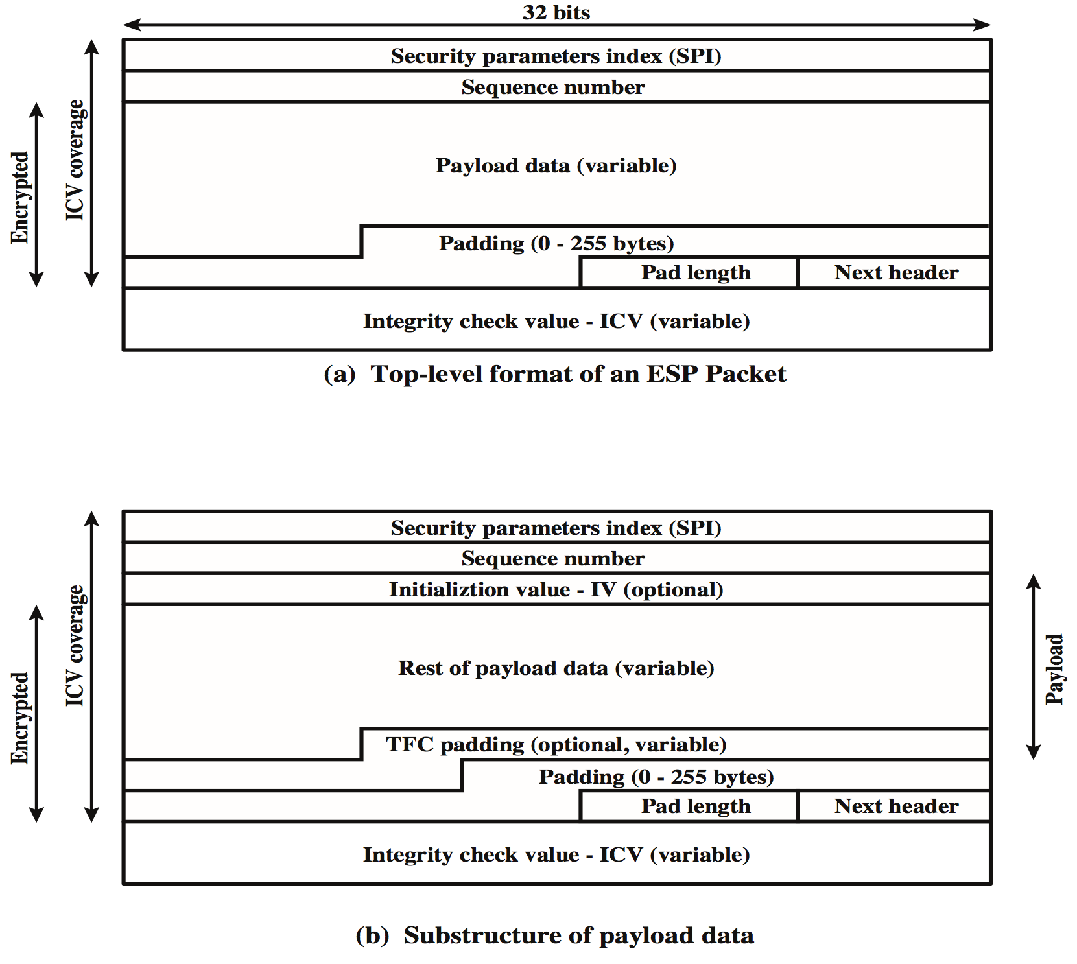
ESP Format
Notes:
Figure 9.5a shows the top-level format of an ESP packet. It contains the following
fields.
• Security Parameters Index (32 bits): Identifies a security association.
• Sequence Number (32 bits): A monotonically increasing counter value; this
provides an anti-replay function, as discussed for AH.
• Payload Data (variable): This is a transport-level segment (transport mode)
or IP packet (tunnel mode) that is protected by encryption.
• Padding (0–255 bytes): The purpose of this field is discussed later.
• Pad Length (8 bits): Indicates the number of pad bytes immediately preceding
this field.
• Next Header (8 bits): Identifies the type of data contained in the payload data
field by identifying the first header in that payload (e.g., an extension header
in IPv6, or an upper-layer protocol such as TCP).
• Integrity Check Value (variable): A variable-length field (must be an integral
number of 32-bit words) that contains the Integrity Check Value computed
over the ESP packet minus the Authentication Data field.
When any combined mode algorithm is employed, the algorithm itself is expected
to return both decrypted plaintext and a pass/fail indication for the integrity
check. For combined mode algorithms, the ICV that would normally appear at the
end of the ESP packet (when integrity is selected) may be omitted. When the ICV
is omitted and integrity is selected, it is the responsibility of the combined mode
algorithm to encode within the Payload Data an ICV-equivalent means of verifying
the integrity of the packet.
Two additional fields may be present in the payload (Figure 9.5b). An initialization
value (IV) , or nonce, is present if this is required by the encryption or
authenticated encryption algorithm used for ESP. If tunnel mode is being used, then
the IPsec implementation may add traffic flow confidentiality (TFC) padding after
the Payload Data and before the Padding field, as explained subsequently.

Slide 5
Anti-Replay Mechanism
Notes:
A replay attack is one in which an attacker obtains a copy of an authenticated
packet and later transmits it to the intended destination. The receipt of duplicate,
authenticated IP packets may disrupt service in some way or may have some other
undesired consequence. The Sequence Number field is designed to thwart such attacks.
First, we discuss sequence number generation by the sender, and then we
look at how it is processed by the recipient.
When a new SA is established, the sender initializes a sequence number
counter to 0. Each time that a packet is sent on this SA, the sender increments the
counter and places the value in the Sequence Number field. Thus, the first value
to be used is 1. If anti-replay is enabled (the default), the sender must not allow
the sequence number to cycle past 2³² - 1 back to zero. Otherwise, there would
be multiple valid packets with the same sequence number. If the limit of 2³² - 1
is reached, the sender should terminate this SA and negotiate a new SA with a
new key.
Because IP is a connectionless, unreliable service, the protocol does not
guarantee that packets will be delivered in order and does not guarantee that all
packets will be delivered. Therefore, the IPsec authentication document dictates
that the receiver should implement a window of size W , with a default of W = 64.
The right edge of the window represents the highest sequence number, N , so far
received for a valid packet. For any packet with a sequence number in the range from
N - W + 1 to N that has been correctly received (i.e., properly authenticated), the
corresponding slot in the window is marked (Figure 9.6). Inbound processing proceeds
as follows when a packet is received:
1. If the received packet falls within the window and is new, the MAC is checked.
If the packet is authenticated, the corresponding slot in the window is marked.
2. If the received packet is to the right of the window and is new, the MAC is
checked. If the packet is authenticated, the window is advanced so that this
sequence number is the right edge of the window, and the corresponding slot
in the window is marked.
3. If the received packet is to the left of the window or if authentication fails, the
packet is discarded; this is an auditable event.

Slide 6
Combining Security Associations
An individual SA can implement either the AH or ESP protocol but not both
Security association bundle
Refers to a sequence of SAs through which traffic must be processed to provide a desired set of IPsec services
The SAs in a bundle may terminate at different endpoints or at the same endpoint
May be combined into bundles in two ways:
Transport adjacency
Refers to applying more than one security protocol to the same IP packet without invoking tunneling
This approach allows for only one level of combination
Iterated tunneling
Refers to the application of multiple layers of security protocols effected through IP tunneling
This approach allows for multiple levels of nesting
Notes:
An individual SA can implement either the AH or ESP protocol but not both.
Sometimes a particular traffic flow will call for the services provided by both AH
and ESP. Further, a particular traffic flow may require IPsec services between
hosts and, for that same flow, separate services between security gateways, such as
firewalls. In all of these cases, multiple SAs must be employed for the same traffic
flow to achieve the desired IPsec services. The term security association bundle refers
to a sequence of SAs through which traffic must be processed to provide a desired
set of IPsec services. The SAs in a bundle may terminate at different endpoints
or at the same endpoints.
Security associations may be combined into bundles in two ways:
• Transport adjacency: Refers to applying more than one security protocol to
the same IP packet without invoking tunneling. This approach to combining
AH and ESP allows for only one level of combination; further nesting yields
no added benefit since the processing is performed at one IPsec instance: the
(ultimate) destination.
• Iterated tunneling: Refers to the application of multiple layers of security protocols
effected through IP tunneling. This approach allows for multiple levels
of nesting, since each tunnel can originate or terminate at a different IPsec site
along the path.
The two approaches can be combined, for example, by having a transport SA between
hosts travel part of the way through a tunnel SA between security gateways.
One interesting issue that arises when considering SA bundles is the order in
which authentication and encryption may be applied between a given pair of endpoints
and the ways of doing so.

Slide 7
Combinations of Security Associations
Notes:
The IPsec Architecture document lists four examples of combinations of SAs that
must be supported by compliant IPsec hosts (e.g., workstation, server) or security
gateways (e.g., firewall, router). These are illustrated in Figure 9.10. The lower
part of each case in the figure represents the physical connectivity of the elements;
the upper part represents logical connectivity via one or more nested SAs. Each SA
can be either AH or ESP. For host-to-host SAs, the mode may be either transport
or tunnel; otherwise it must be tunnel mode.

Slide 8
Internet Key Exchange
The key management portion of IPsec involves the determination and distribution of secret keys
A typical requirement is four keys for communication between two applications
Transmit and receive pairs for both integrity and confidentiality
The IPsec Architecture document mandates support for two types of key management:
Manual
A system administrator manually configures each system with its own keys and with the keys of other communicating systems
This is practical for small, relatively static environments
Automated
Enables the on-demand creation of keys for SAs and facilitates the use of keys in a large distributed system with an evolving configuration
Notes:
The key management portion of IPsec involves the determination and distribution
of secret keys. A typical requirement is four keys for communication
between two applications: transmit and receive pairs for both integrity and confidentiality.
The IPsec Architecture document mandates support for two types of
key management:
• Manual: A system administrator manually configures each system with its own
keys and with the keys of other communicating systems. This is practical for
small, relatively static environments.
• Automated: An automated system enables the on-demand creation of keys
for SAs and facilitates the use of keys in a large distributed system with an
evolving configuration.

Slide 9
Features of IKE Key Determination
Algorithm characterized by 5 important features:
1.
2.
3.
4.
5.
It employs a mechanism known as cookies to thwart clogging attacks
It enables the two parties to negotiate a group; this, in essence, specifies the global parameters of the Diffie-Hellman key exchange
It uses nonces to ensure against replay attacks
It enables the exchange of Diffie-Hellman public key values
It authenticates the Diffie-Hellman exchange to thwart man-in-the-middle-attacks
Notes:
The IKE key determination algorithm is
characterized by five important features:
1. It employs a mechanism known as cookies to thwart clogging attacks.
2. It enables the two parties to negotiate a group ; this, in essence, specifies the
global parameters of the Diffie-Hellman key exchange.
3. It uses nonces to ensure against replay attacks.
4. It enables the exchange of Diffie-Hellman public key values.
5. It authenticates the Diffie-Hellman exchange to thwart man-in-the-middle
attacks.

